Slide 1
Capstone Project_Analysis
By_Shivanshu Kumar Srivastava

Slide 2
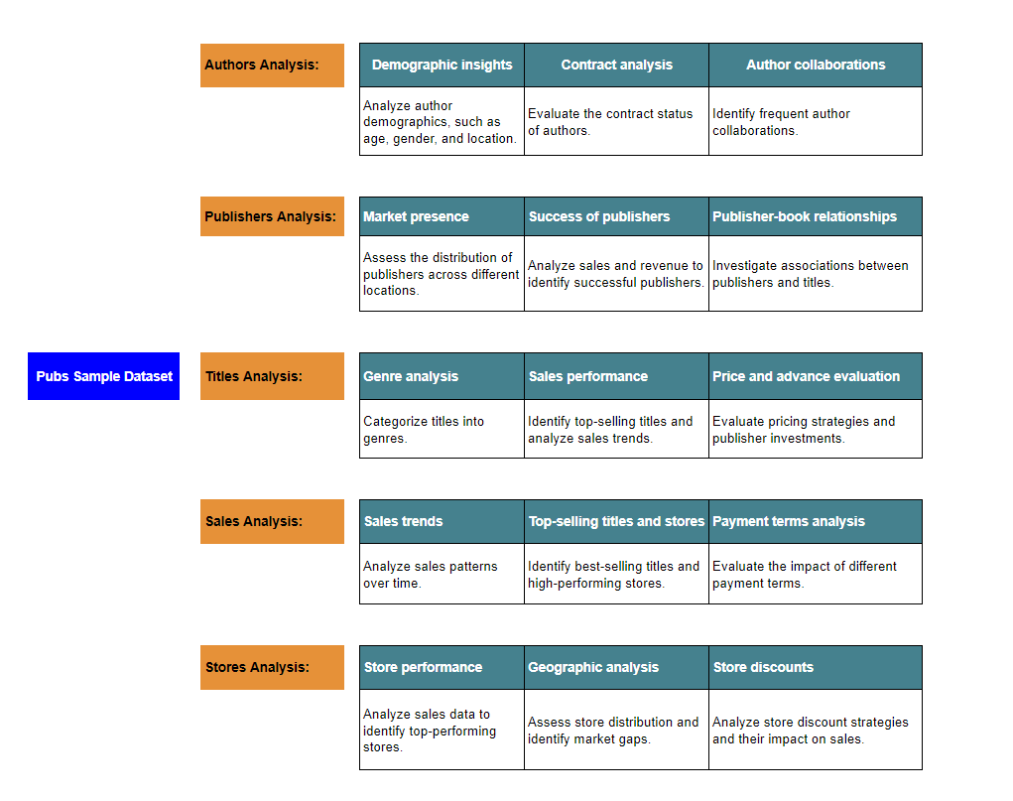
Publications

Slide 3
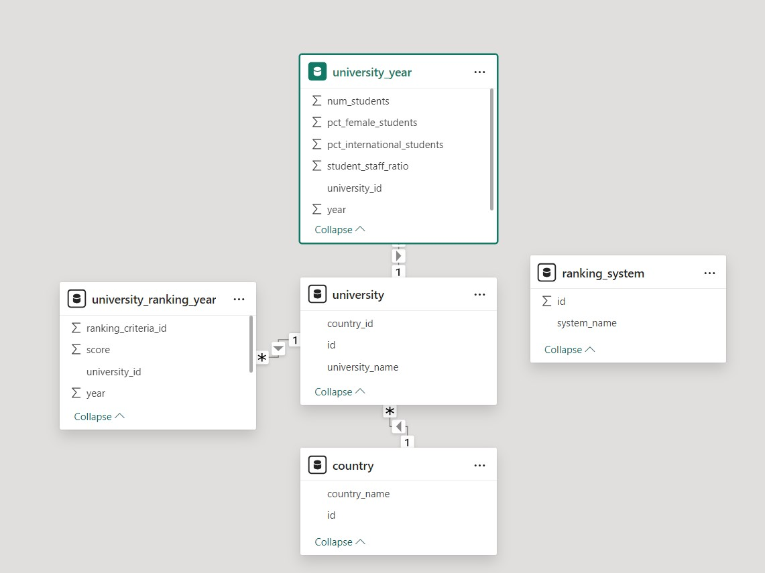
ER Diagram

Slide 4
Power Bi Problem Statements

Slide 5

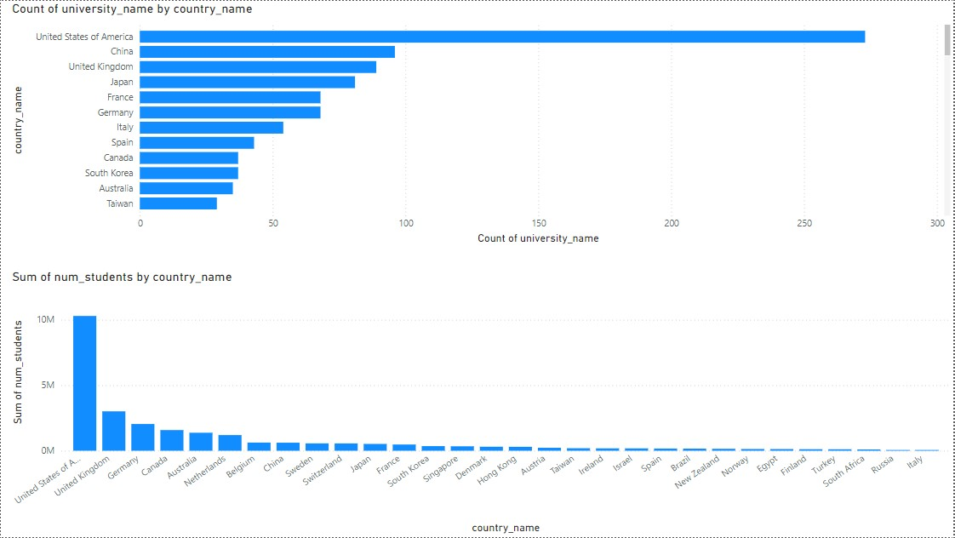
Author Analysis

Slide 6
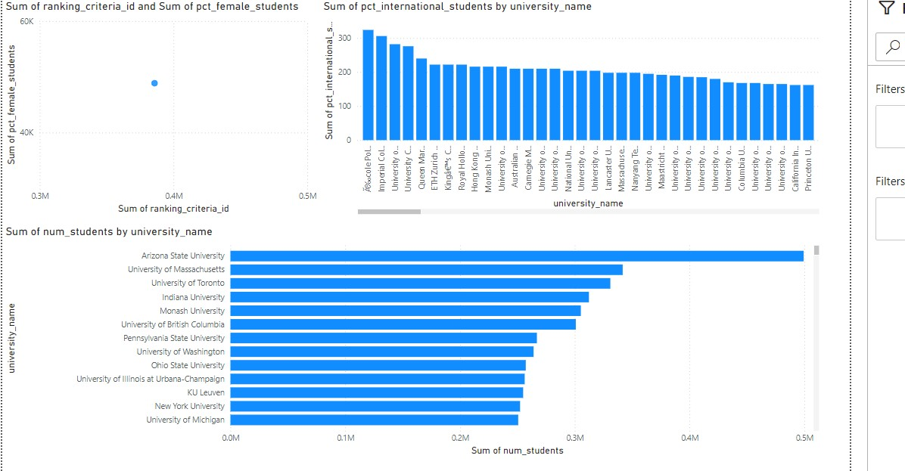
Publishers Analysis

Slide 7

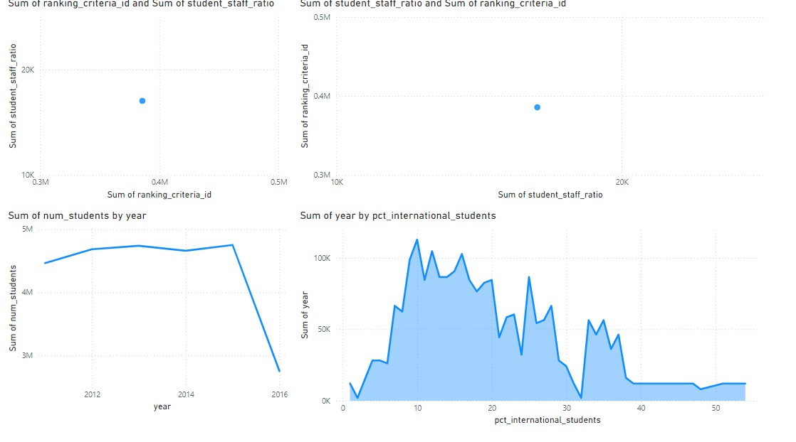
Title Analysis

Slide 8
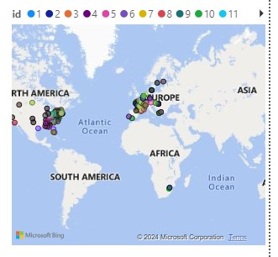
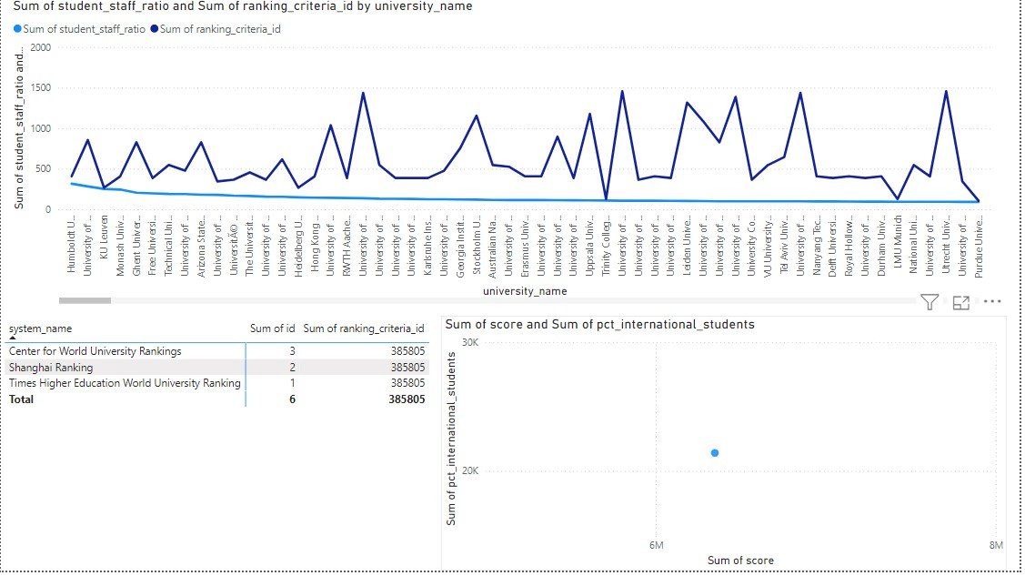
Store Analysis

Slide 9
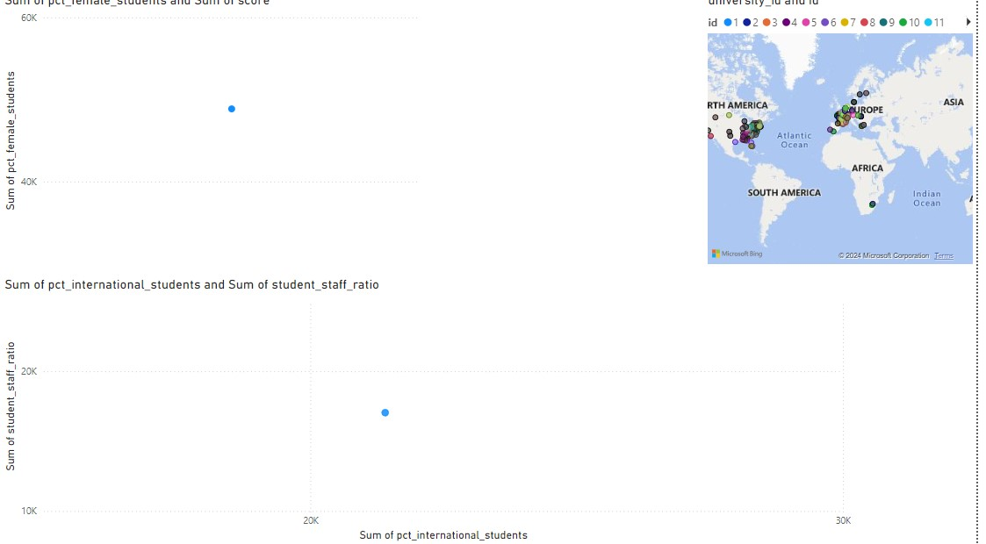
Sales Analysis

